Slide 1
Asp.net Life Cycle
When an ASP.NET page runs, the page goes through a life cycle in which it performs a series of processing steps.
In Each step some events get executed those Events are called Page Life Cycle Events.
Step | Event
Start | Page_PreInit
Page initialization | Page_Init
Load | Page_Load
Validation
Event Handling | Page_DataBinding Page_PreRender
Rendering | Page_Render
Unload | Page_Dispose Page_Unload

Slide 2
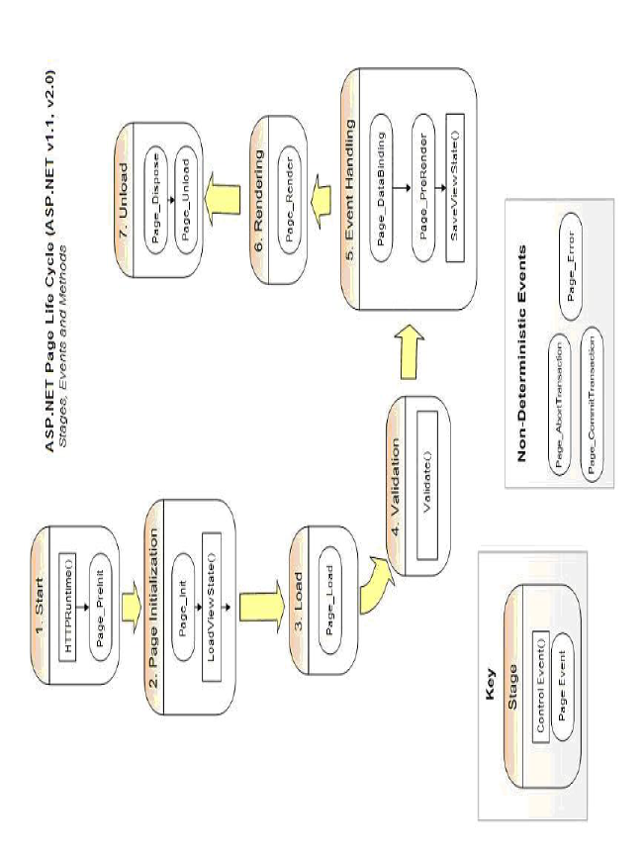
Asp.net Life Cycle

Slide 3
Start
In the start stage, page properties such as Request and Response are set.
At this stage, the page also determines whether the request is a postback or a new request and sets the IsPostBack property.
The page also sets the UICulture property.
Page_PreInit:
Create dynamic controls
Set the Master page dynamically
Set the Theme property dynamically
Set the Cultureproperty
Read or set the Profile property values

Slide 4
Page initialization
During page initialization, controls on the page are available and each control's UniqueID property is set.
A master page and themes are also applied to the page if applicable.
Page_Init:
Read or Initialize Control properties.
skin settings have been applied.
Setup handlers for events
Load external template files

Slide 5
Load
During load, if the current request is a postback, control properties are loaded with information recovered from view state and control state.
Page_Load:
If the page is being processed for the first time (Can be verified using the IsPostBackproperty), then the initial binding activity will be performed.
Read and Load the control properties

Slide 6
Asp.net Life Cycle
Validation:
Validates information assigned to validation controls.
Event handling:
Use these events to handle specific control events, such as a Button control's Click event or a TextBox control's TextChanged
Page_PreRender:
Make final modifications to the page
SaveViewState()

Slide 7
Rendering
this stage of processing, the Page object calls this method on each control. All ASP.NET Web server controls have a Render method that writes out the control's markup to send to the browser.
Page_Render:
Make changes to the HTML of a page
Write text for controls on a page
Unload:
Page_Dispose:
Discard objects used in the page, including the Page object
Page_Unload:
Close open files
Close open database connections
Finish logging or other request-specific tasks

Slide 8
Asp.net Life Cycle
Auto Event wireup Attribute:
This is provided with page directive
This can take true/false
True[default]------asp. net engine will look for sub program names with life cycle event names for execution
False --------asp. net engine will not execute life cycle events
The false option is recommended to improve performance ,if webpage does not require life cycle events.

